Slide 1
Object Oriented Design Patterns Observer
James.Fennell@lit.ie

Slide 2
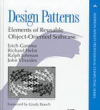
What is are Design Patterns
Design Patterns: Elements of Reusable Object-Oriented Software (1994) is a software engineering book describing software design patterns
The book was written by Erich Gamma, Richard Helm, Ralph Johnson, and John Vlissides - referred to as the Gang of Four (GoF)
The book described 23 classic software design patterns
The book includes examples in C++ and Smalltalk.
It has been influential to the field of software engineering and is regarded as an important source for object-oriented design theory and practice

Slide 3
Interfaces https://www.tutorialspoint.com/java/java_interfaces.htm
An interface is a reference type in Java
It is similar to class
It is a collection of abstract methods
A class implements an interface, thereby inheriting the abstract methods of the interface
An interface may also contain constants, default methods, static methods, and nested types
Interface method bodies exist only for default methods and static methods
Writing an interface is similar to writing a class
An interface contains behaviours that a class implements
A class describes the attributes and behaviours of an object
Unless the class that implements the interface is abstract, all the methods of the interface need to be defined in the class

Slide 4
The Observer
The Observer is a behavioural Design Pattern
An Observor allows us to have multiple objects/classes observe a Subject class
If the Observers are interested in events in the Subject class the Subject notifies all Observers of the update

Slide 5
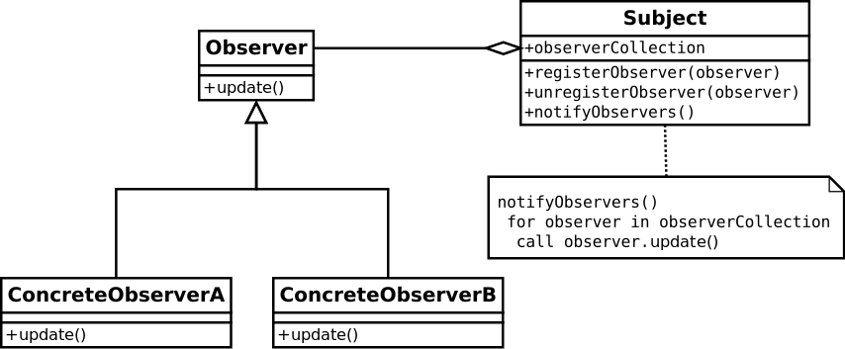
The Observer
Here we see the Observer interface implemented by the ConcreteObserverA and ConcreteObserverB objects
The subject has a one to many relationship with the Observer interface
We see the Observer interface has the method update
The Subject has:
A collection of Observers
methods to add and remove Observers
a method to notify all the Observers

Slide 6
The Observer
In the UML the Observer’s update method does not take any arguments
In most use-cases it will make sense to pass information to the update method
Note that
The Subject is pushing the updates to the Observers
The Subject holds a reference to every individual Observer that registers
There is no limit to the amount of subscribers a Subject may have

Slide 7
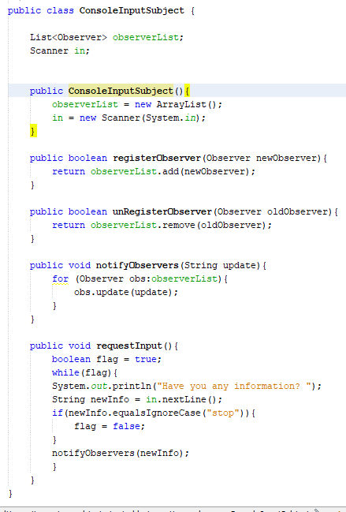
Consider the Observer Sample
We have a Subject that implements all of the required methods from the Observer Pattern
registerObserver
unregisterObserver
notifyObservers
We also include a requestInput method which we will use to input updates from the Console to generate updates for the Observers

Slide 8
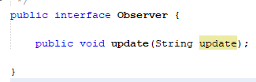
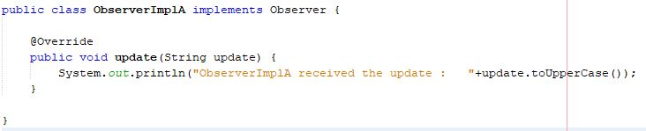
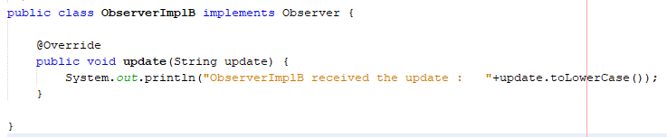
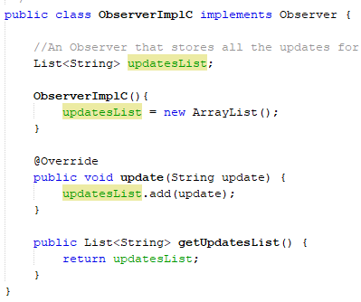
Consider the Observer Sample
We have an Observer interface that is implemented by three different classes
ObserverImplA
prints out the String in upper case
ObserverImplB
prints out the String in upper case
ObserverImplC
Stores all received updates in a list

Slide 9
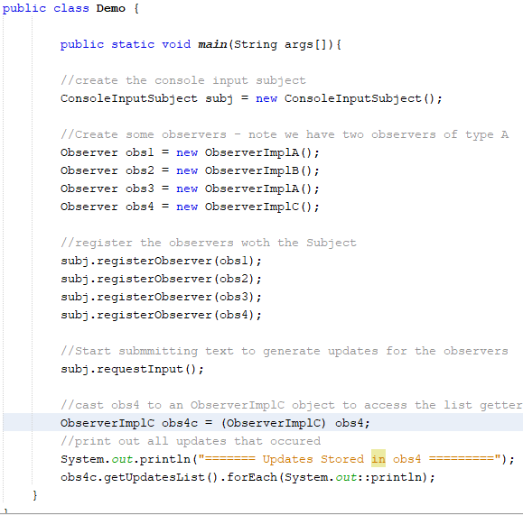
Observer Sample Pull it All together
We create a simple app to demonstrate the Observers working
Create a Subject that will generate updates
Register some Observers with the subject
Start generating updates for in the Subject
We added some more code in the main method to retrieve the values stored in obs4

Slide 10
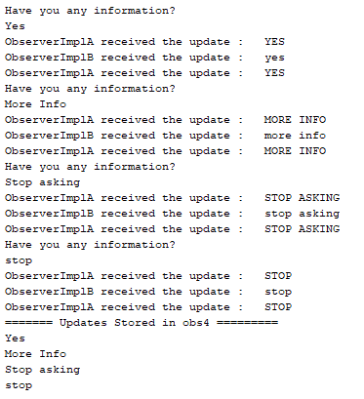
Observer Sample Pull it All together
Run the file
submit some updates
Check the output

Slide 11


